Slide 1
Lending Club Case Study
Group Members:
Tirth Shah
Shankar KV

Slide 2
Problem statement
The company wants to find out which factors cause borrowers to default on their loans. By identifying these factors using data analysis, the company can reduce loans to high-risk applicants and minimise financial losses. The company can utilize this knowledge for its portfolio and risk assessment.

Slide 3
Objectives
Implement EDA techniques to analyse real-world loan data and gain actionable insights.
Identify key factors contributing to loan defaults to reduce business losses.
Develop a basic understanding of risk analytics in the banking and financial services industry.
Present findings in a business-focused manner to support decision-making.

Slide 4
Approach
Data Overview
Data Clean Up
Find Variables of Interest
Data Visualization
Perform Analysis
Identifying Patterns and Anomalies
Data Overview: Review the dataset to understand its structure, types of variables, and basic statistics.
Data Cleanup: Remove the null fields, irrelevant fields, treat missing data, outliers.
Identify Variables of Interest: Identify key variables such as loan amount, interest rate, term, grade, and loan status.
Data Visualization: Create visualizations such as histograms, box plots, scatter plots, and bar charts to explore distributions, relationships, and trends within the data.
Perform Analysis: Compute correlation matrices and use heatmaps to identify relationships between numerical variables..
Identifying Patterns and Anomalies: Analyze patterns and detect anomalies or outliers in the data. This includes examining loan performance across different borrower segments (e.g., by grade or purpose) and identifying any unusual patterns or trends that could impact the analysis.

Slide 5
Data Clean Up
The data contains information about past loan applicants and whether they ‘defaulted’ or not
Import Data
Remove Fields that has more than 50% Null Values
Fix Nulls <2%
Identify Fields of Interest
Correct Data Types
Remove Outliers
Create Derived Fields
Loan data is for all loans issued through the time period 2007 to 2011.
These are the steps followed in Data Cleanup

Slide 6
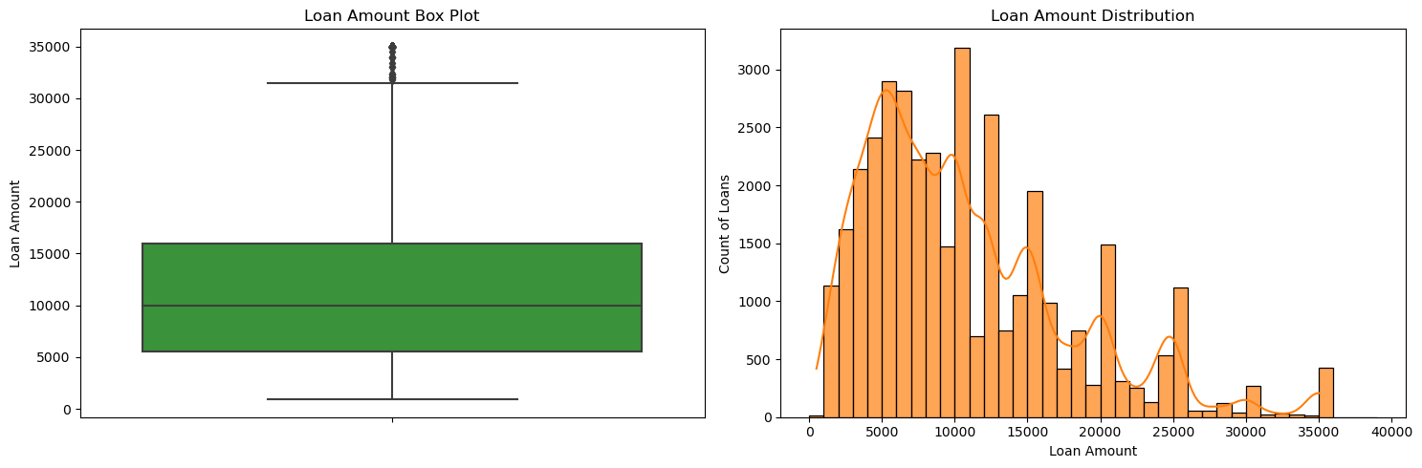
EDA- Univariate
Loan Amount Distribution
Inference- Most of loans amount and funded amount is between 5k-15k, with highest range around 30-35K

Slide 7
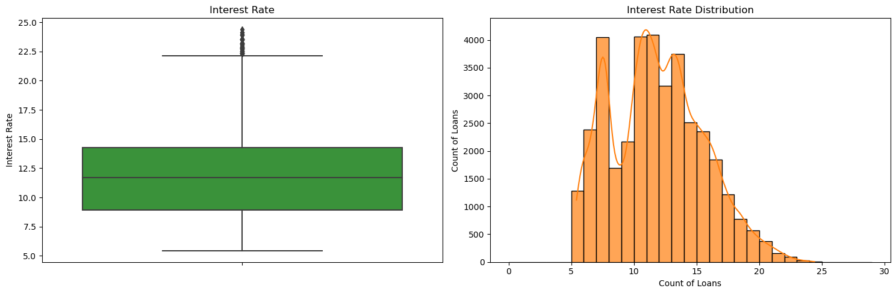
EDA- Univariate
Interest Rate Distribution
Inference: Majority of loans have Interest rate in the rage of 10-15%

Slide 8
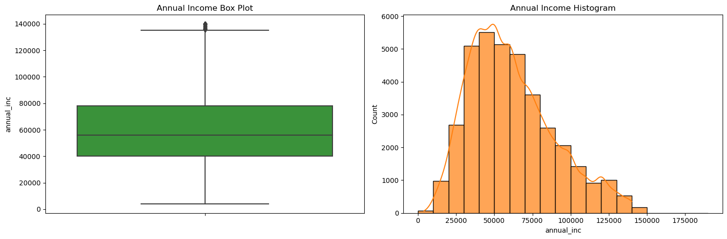
EDA- Univariate
Annual Income Distribution
Inference: After removing outliers, it can be seen most of the borrower's annual income range between 40-80K

Slide 9
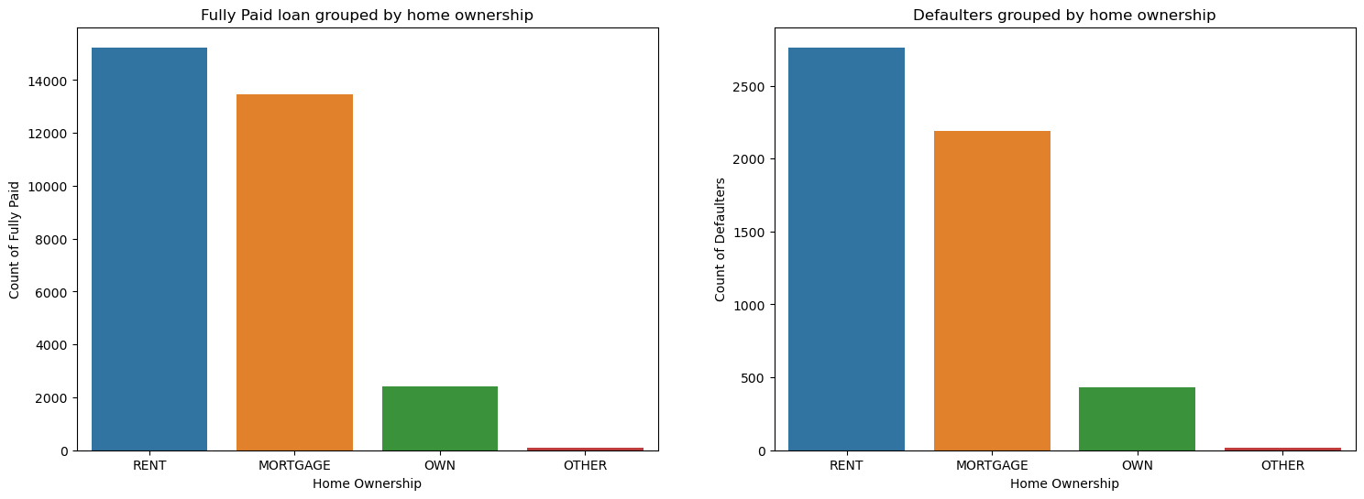
EDA- Segmented/Categorical Variable
Home Ownership
Inference: Very less borrowers have OWN house.

Slide 10
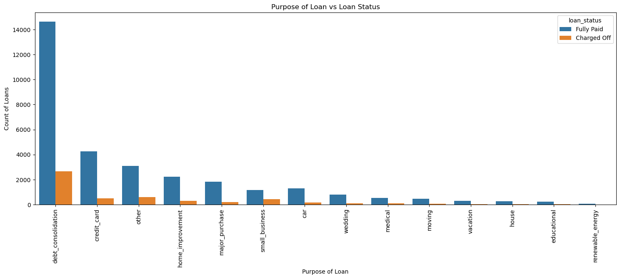
EDA- Segmented/Categorical Variable
Loan Purpose
Inference: Debt consolidation is one of the biggest reason for loans

Slide 11
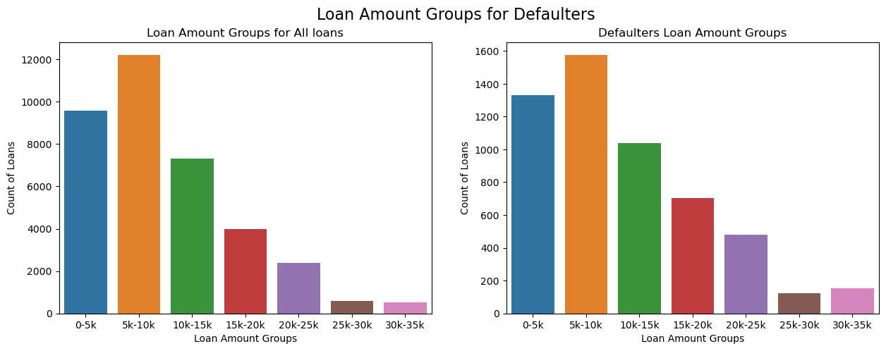
EDA- Segmented/Categorical Variable
Loan Amount Groups grouped by Loan status
Inference: Debt consolidation is one of the biggest reason for loans

Slide 12
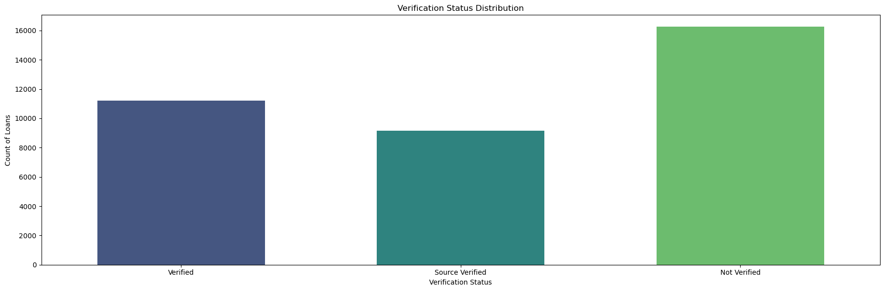
EDA- Segmented/Categorical Variable
Verification Status
Inference: 50% of Loans are not Verified

Slide 13
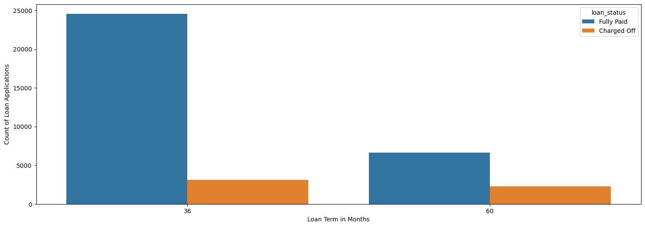
EDA- Segmented/Categorical Variable
Loan Term
Inference: High loan term increases chance of defaulting

Slide 14
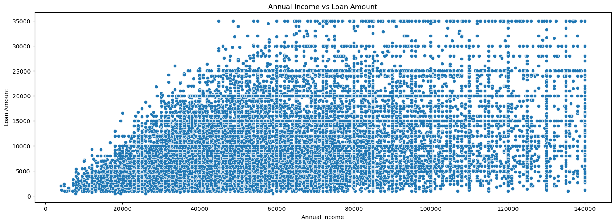
EDA- Bi-Variate Analysis
Annual Income Vs Loan Amount
Inference: Annual Income and Loan Amount are weakly correlated. Higher income means defaulting chances are less

Slide 15
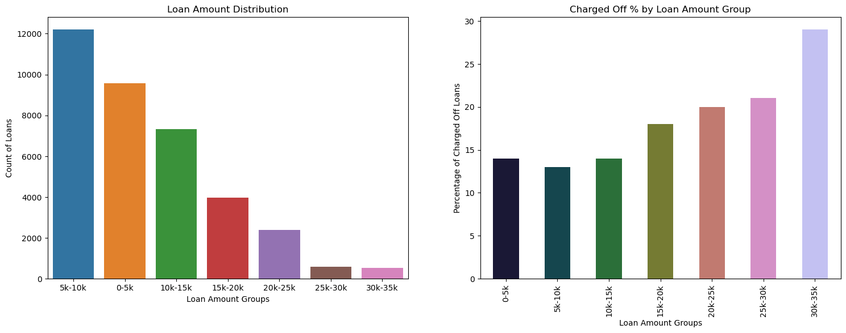
EDA- Bi-Variate Analysis
Finding Loan Amount groups and its Charged off Percentage
Inference: Loan Granted vs Charged off, when compared to Loan Granted, 30% of Loans are charged off in range 30-35K, when compared to overall charged off percentage 16%

Slide 16
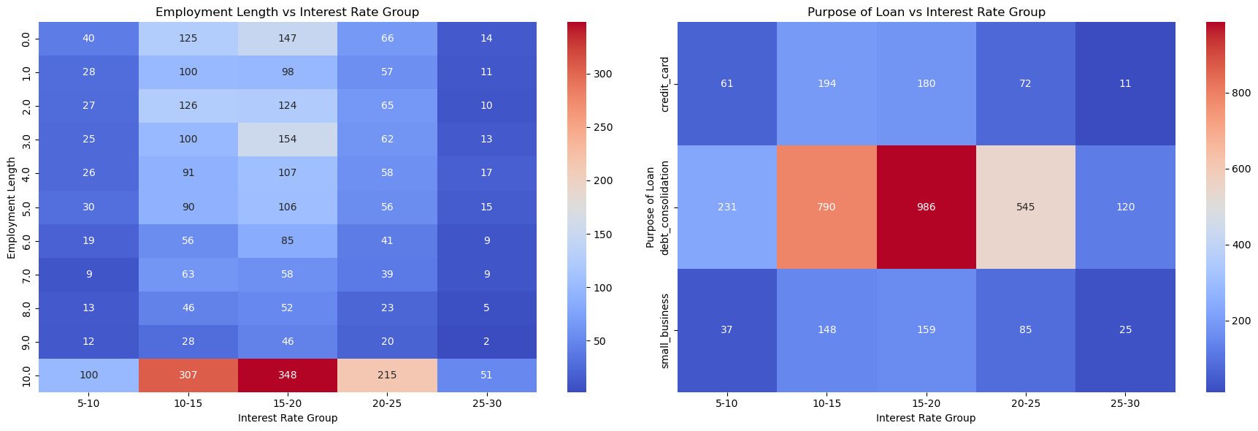
EDA- Bi-Variate Analysis
Analyse Employment Duration, Loan Amount, Interest Rate, Purpose, Credit Grade of Defaulters, to identify a pattern.
Only Debt Consolidation, Small Business, Credit Card loan purposes were considered.
Inference : Debt Consolidation with employment length of 10+ years and interest rate group 10-15% has the highest number of defaulters. Risky

Slide 17
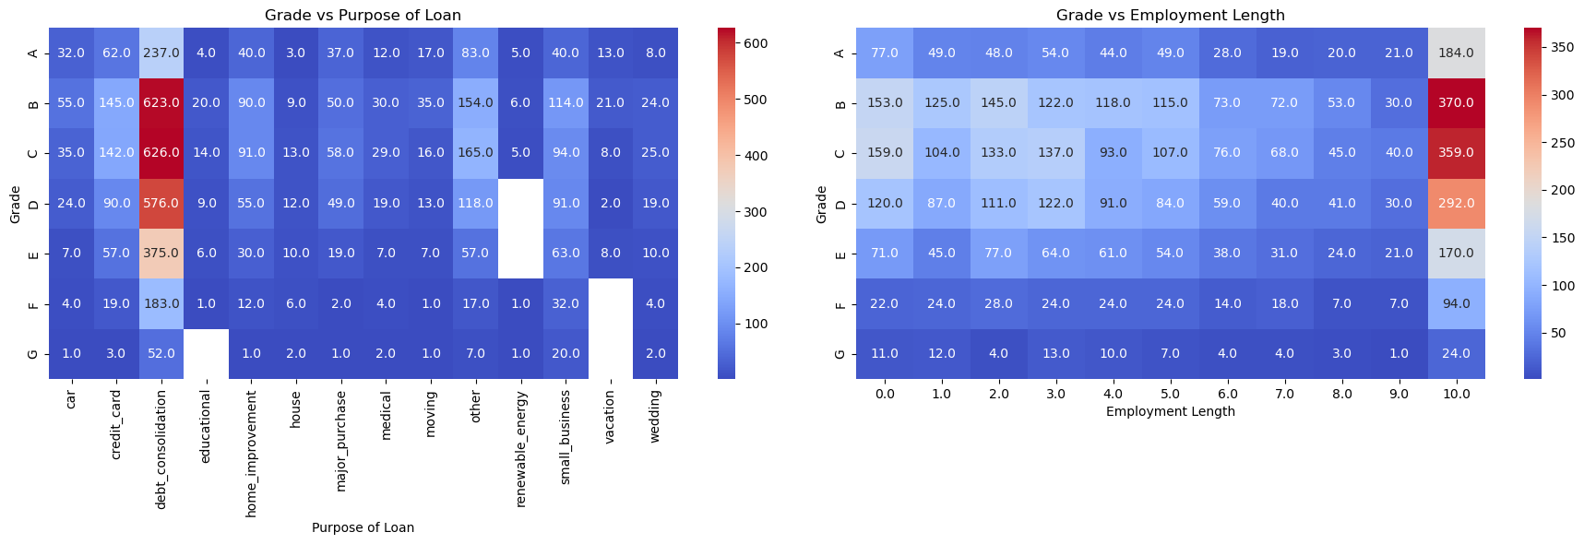
EDA- Bi-Variate Analysis
Analyse loan Grade vs Purpose of loan vs emp duration for defaulters
Inference: Debt Consolidation with Loan grade in B, C D with employment length of 10+ years are the major defaulters.

Slide 18
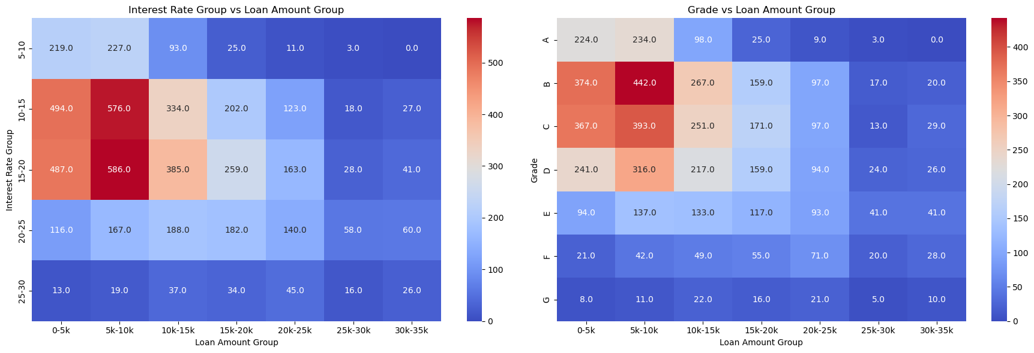
EDA- Bi-Variate Analysis
Analyse loan Grade vs Purpose of loan vs emp duration, Interest Rate
Continued to Next Slide…

Slide 19
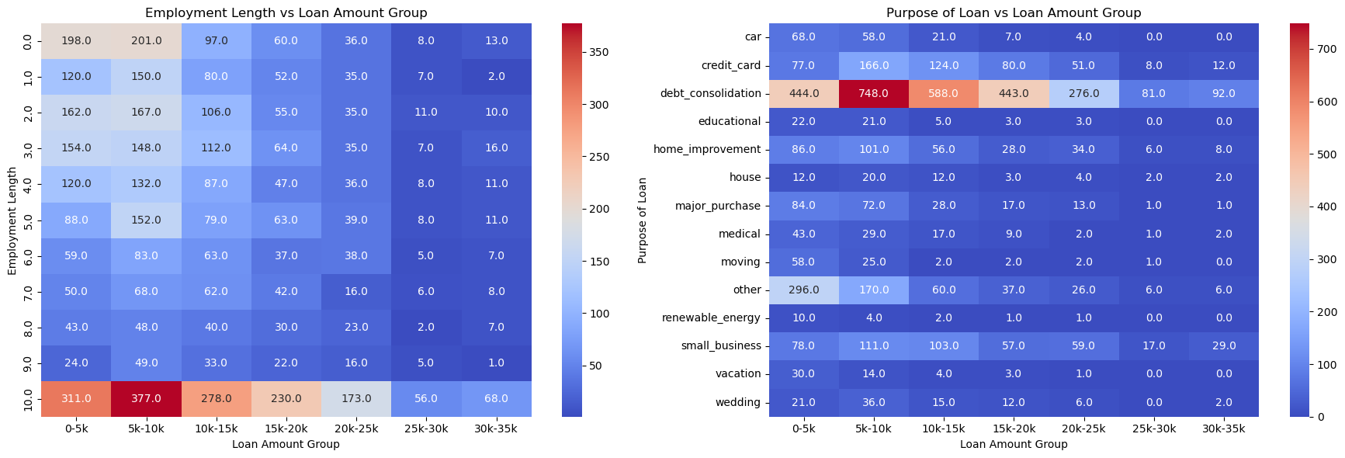
EDA- Bi-Variate Analysis
Analyse loan Grade vs Purpose of loan vs emp duration, Interest Rate
Inference: 10+ Years Employment length with interest in the range of 10%-20%, with credit grade of B,C & D with loan value in the rage of 5k-20K, with loan purpose as Debt Consolidation are the riskiest loan

Slide 20
Conculsion
Goal : Understand the driving factors (or driver variables) behind loan default
Annual Income
Loan Amount
Interest Rate
Loan Purpose
Employment Duration
Loan/Credit Grade
Other Findings using EDA
Loans with 10+ years employment, 10%-20% interest rates, credit grades B, C, D, 5K - 20K amounts, and debt consolidation purpose are riskiest.
Defaulters' loans are 20%-35% of annual income, with higher median interest rates.
Nearly 50% of high loan amounts get defaulted; high loan amounts and interest rates are risky.
Most defaulters rent or have a mortgage, indicating financial burden may lead to defaults.

